Slide 1
DIO (LS-2-2101)
Static Configuration
Rack #
Slot #
Banks 0-3
Logic Threshold (%)
Lines (Nx8)+1 -> (Nx8)+8, N = Bank #
Line: Input = 0 or Output = 1
MCP23S17 Addresses
Bank 0 = 0b00
Bank 1 = 0b01
Bank 2 = 0b10
Bank 3 = 0b11
Switch to Bank 0
Reg = x05
Data = x0000
Config for Sequential Addressing
Reg = 0x0A
Data = x08
Dynamic Configuration
None
Change Mode to Outputs
Reg = x00
Data = x0000
MCP23S17 Digital Pin Configuration
MSB
LSB
…
Threshold Byte
Update Input/Output & Logic Config Reg = x12
Line (Nx8)+8
Line (Nx8)+1
Threshold Byte = [255 x Logic Threshold (%)]/100

Slide 2
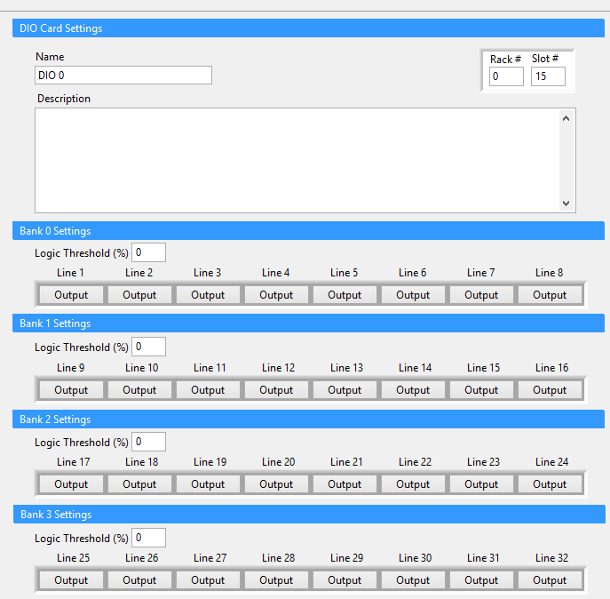
DIO in VeriStand

Slide 3
FIU (LS-2-2502/LS-2-2501)
Static Configuration
Rack #
Slot #
Banks 0-1
Faults (Nx4)+1 -> (Nx4)+4, N = Bank #
Initial Fault States: No Fault Output 1 = 0, Open Circuit 100 Hz = 1, Ground 100 Hz = 2, Open Circuit = 3, Ground = 4, Fail Rail 1 = 5, Fail Rail 2= 6, No Fault Output 2 = 7
MCP23S17 Addresses
Bank 0 = 0b00
Bank 1 = 0b01
Switch to Bank 0
Reg = x05
Data = x0000
Config for Sequential Addressing
Reg = 0x0A
Data = x08
Dynamic Configuration
Fault States of Faults (Nx4)+1 -> (Nx4)+4
Change Mode to Outputs
Reg = x00
Data = x0000
MCP23S17 Digital Pin Configuration
MSB
LSB
Update Fault States
Reg = x12
0
0
0
0
Fault (Nx4)+2
Fault (Nx4)+1
Fault (Nx4)+4
Fault (Nx4)+3

Slide 4
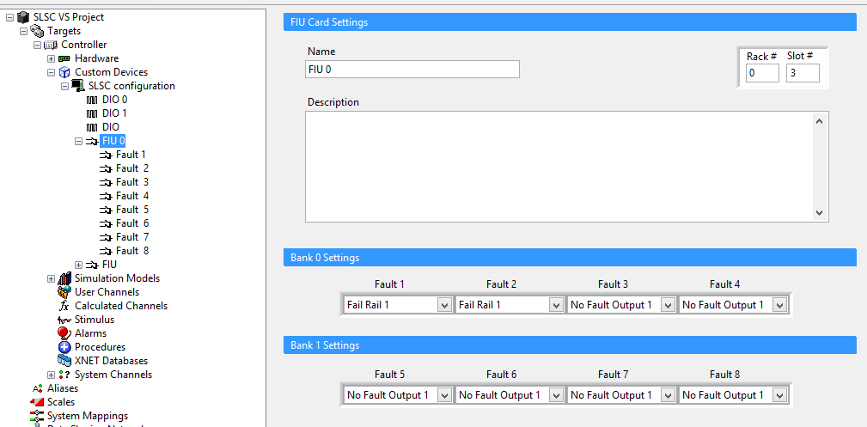
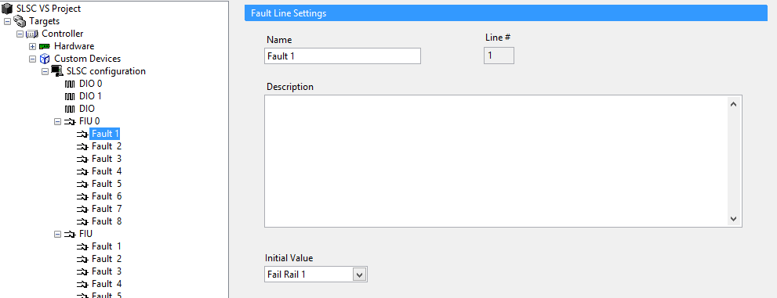
FIU in VeriStand

Slide 5
Battery Switch (LS-2-3010)
Static Configuration
Rack #
Slot #
Banks 0
Switch 1-3
Switch: 1 = Battery Power to output, 0 = No battery power to output
MCP23S17 Addresses
Bank 0 = 0b00
Switch to Bank 0
Reg = x05
Data = x0000
Config for Sequential Addressing
Reg = 0x0A
Data = x08
Dynamic Configuration
Switch channels 1-3 to battery power (=1) or no battery power (=0)
Change Mode to Outputs
Reg = x00
Data = x0000
MCP23S17 Digital Pin Configuration
MSB
LSB
Update
Reg = x12
Switch 3
Switch 1
Switch 2

Slide 6
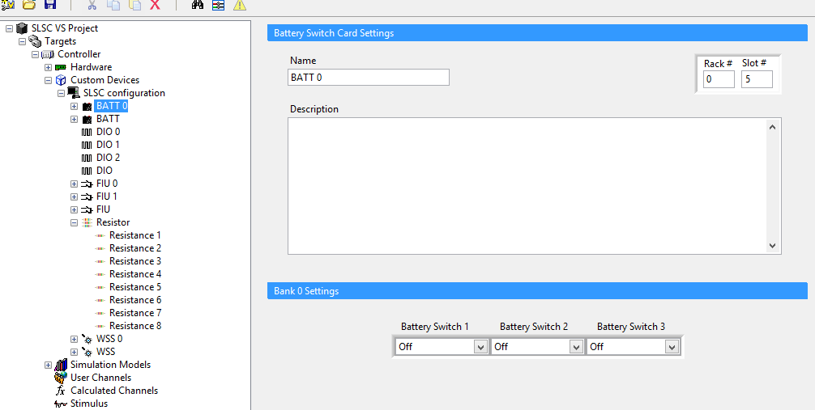
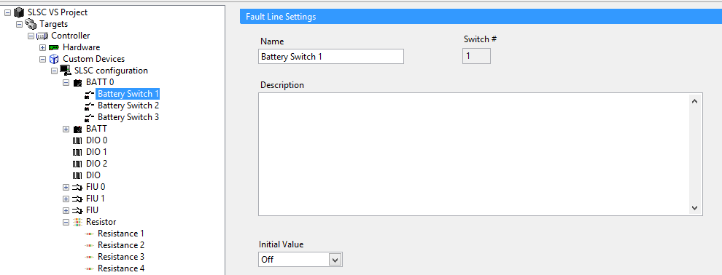
Battery Switch in VeriStand

Slide 7
Wheel Speed Sensor (LS-2-2751)
Static Configuration
Rack #
Slot #
Bank 0
Channels 1-4
Channel: Current Mode = 1, Voltage Mode = 0
MCP23S17 Addresses
Bank = 0b00
Switch to Bank 0
Reg = x05
Data = x0000
Config for Sequential Addressing
Reg = 0x0A
Data = x08
Dynamic Configuration
Change mode channel by channel
Change Mode to Outputs
Reg = x00
Data = x0000
MCP23S17 Digital Pin Configuration
MSB
LSB
Update
Reg = x12
Channel 4
Channel 3
Channel 1
Channel 2

Slide 8
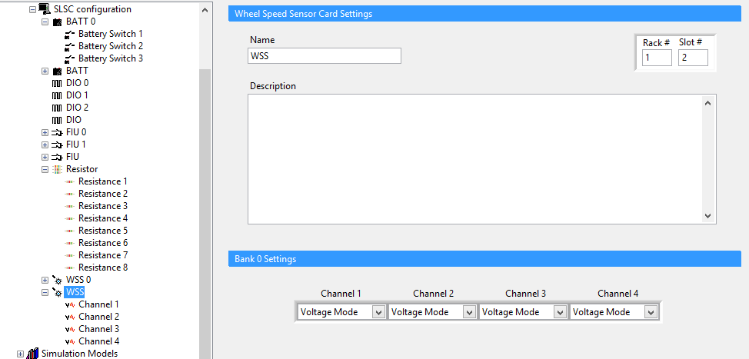
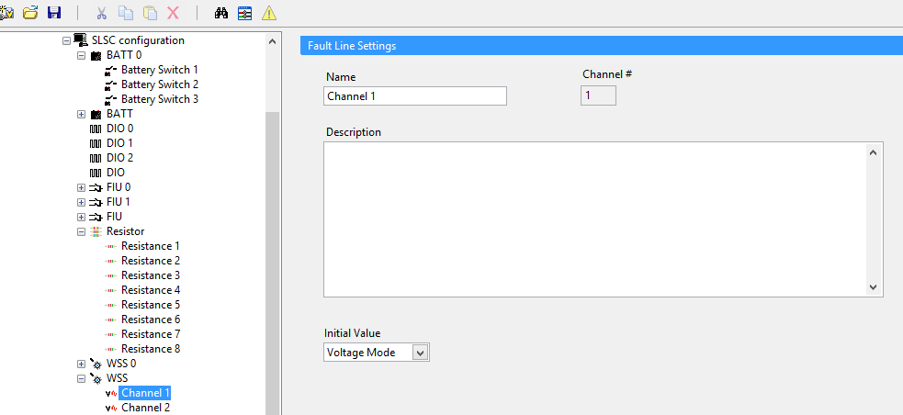
Wheel Speed Sensor in VeriStand

Slide 9
Resistor Board (LS-2-2901)
Static Configuration
Rack #
Slot #
Banks 0-7 = Channels 0-7
Resistance = 2 Ohm + (Bit 0) *2^-3 + (Bit 1)*2^-2 + … + (Bit 15)*2^12
MCP23S17 Addresses
Bank 0 = 0b0000
Bank 1 = 0b0001
Bank 2 = 0b0010
Bank 3 = 0b0011
Bank 4 = 0b0100
Bank 5 = 0b0101
Bank 6 = 0b0110
Bank 7 = 0b0111
Switch to Bank 0
Reg = x05
Data = x0000
Config for Sequential Addressing
Reg = 0x0A
Data = x08
Dynamic Configuration
Change resistance
Change Mode to Outputs
Reg = x00
Data = x0000
MCP23S17 Digital Pin Configuration
MSB
LSB
Update
Reg = x12
Bit 7
Bit 0
Bit 16
Bit 8

Slide 10
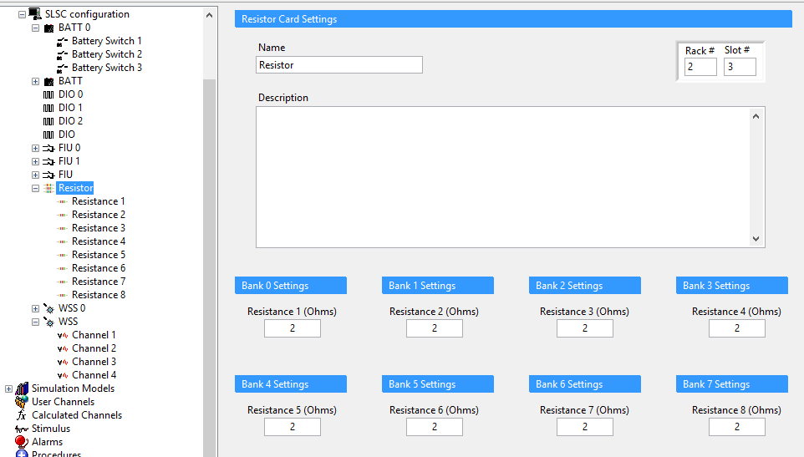
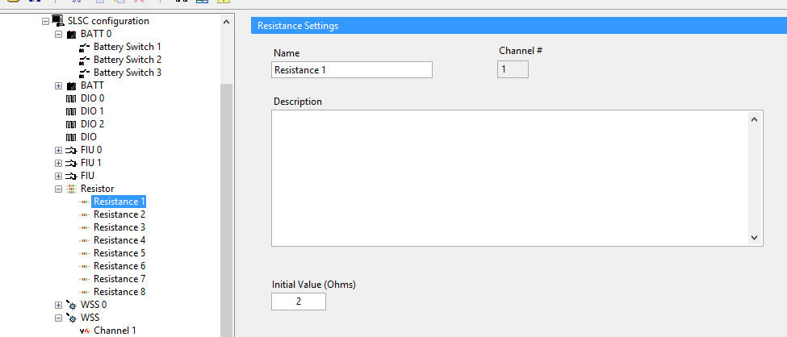
Resistor in VeriStand

Slide 11
UEGO (LS-2-2801)
Static Configuration
Rack #
Slot #
Hardware Settling Time (us)
Calibration Time (us)
MCP23S17 Addresses
None
Assert CS
Assert Calibration
Hardware Settling Time
CS
Deassert Calibration
Cal
Calibration Time
Deassert CS

Slide 12
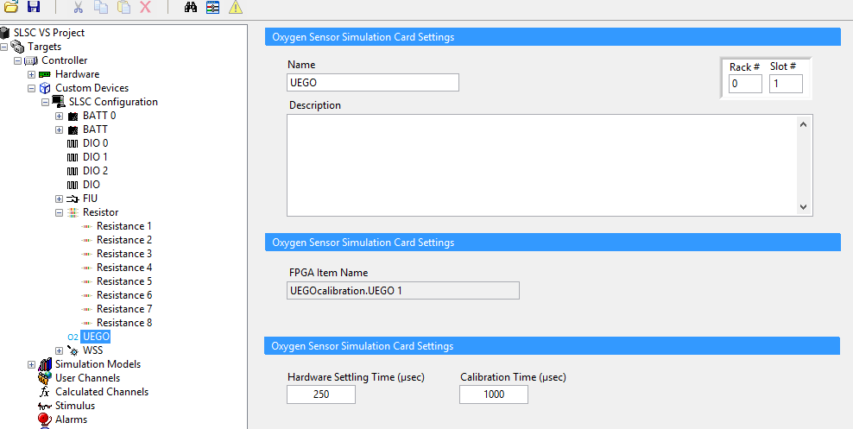
UEGO in VeriStand

Slide 13
Current Sense (LS-2-2202)
Static Configuration
Rack #
Slot #
Bank 0
Line 1 -> Line 16
Line: 1 = Calibration Active, 0 = Calibration Inactive
MCP23S17 Addresses
Bank 0 = 0b00
Switch to Bank 0
Reg = x05
Data = x0000
Config for Sequential Addressing
Reg = 0x0A
Data = x08
Dynamic Configuration
Set Line X to calibrate (set pin = 1) where X = Line # (single VeriStand channel). Only one line can be calibrated at a time. If the channel < 1 or > 16, the system is not calibrating. If the channel >= 1 and <=16, the channel is being calibrated (Line # = Channel value). The user should look at the corresponding AI channel to get offset value.
Change Mode to Outputs
Reg = x00
Data = x0000
MCP23S17 Digital Pin Configuration
MSB
LSB
Update
Reg = x12
…
Line 16
Line 1

Slide 14
LEDs on Backplane
Static Configuration
Rack #
Slot 0 only
Banks 0
LED 1 -> LED 8
Line: 1 = ON, 0 = OFF
MCP23S17 Addresses
Bank 0x00
Switch to Bank 0
Reg = x05
Data = x0000
Config for Sequential Addressing
Reg = 0x0A
Data = x08
Dynamic Configuration
LED 1 -> LED 8
Line: 1 = ON, 0 = OFF
Change Mode to Outputs
Reg = x00
Data = x0000
MCP23S17 Digital Pin Configuration
MSB
LSB
Update
Reg = x12
…
Line 8
Line 1

